Slide 1

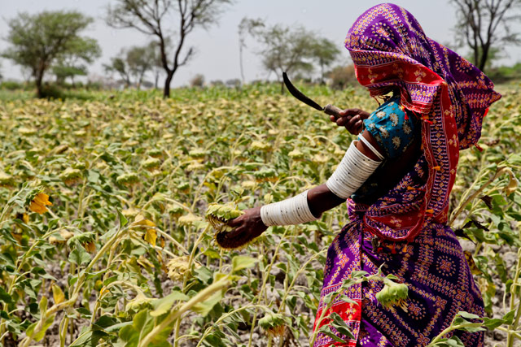
Women in Agriculture
Role of Islamic Microfinance!
A Case Study of Sindh, Pakistan
By: Aijaz Ali Khuwaja
Development Consultant

Slide 2
Background
Sindh is the second largest province of Pakistan in terms of population and economic output.
Sindh contributes almost 33 percent of the national Gross Domestic Product (GDP), It covers 18 percent of Pakistan’s total landmass
Sindh’s current population (Census 2017) is around 42.9 million out of 204.7 million Pakistani population
The province of Sindh comprises of 29 districts that are further divided on the basis of their geographical position and climatic conditions in to three particular regions: upper, middle and lower Sindh
Sindh’s agriculture input is around 40% in overall Pakistani agriculture economy
Sindh is mainly agriculture based. Its main crops include rice, cotton, wheat, sugarcane, mangoes, and bananas. Sindh is known for the quality and quantity of its cotton production. The province has plenty of natural resources including oil, gas, and coal.
Out of total 14 million hectares in Sindh, 5.45 million hectares are cultivable. The remaining area is either hills of Kirther Range, eastern desert of Thar and Achharo Thar, regions.

Slide 3
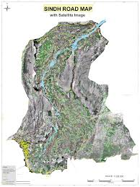
Agriculture Map of Sindh

Slide 4
Women in Agriculture Sector
Pakistan’s agriculture sector involves 43.7% of labor force that produces their own food needs and ensures availability of food for the rest of nation and value added activities.
Men and women farmers are involved in multiple sources of agriculture based livelihoods in Sindh, Pakistan and majority of them are either small subsistence farmers or tenants.
Women in Sindh are involved in crop production from sowing to cultivation to market of products
Rural poverty ratio in Sindh is around 56% (Women are most vulnerable group)
Internal migration from rural to urban areas, especially male, has been increased in last one decade due to less opportunities and land ownership, farming & livelihood issues
This has substantially increased the role of women in both on-farm and off-farm activities along with greater work burden and responsibilities of women at home.

Slide 5
Contribution of Women in Agriculture
  The role of the rural women has not been recognized to the extent they contribute. Their involvement is actually more than men in crop production, livestock and dairy farming
  They are facing multiple issues due to local social and cultural norms.
  During last two decades, many people, mostly men migrated from rural to urban areas of Sindh or abroad in order to improve their income possibilities and to avoid exploitation from local landlords.
  Such conditions have given rural women an active role in on-farm and off-farm activities and has also increased their work burden and responsibilities.
  Women in rural Sindh work on average for 12-14 hours a day.
  Rural women play an important part in agriculture sector activities and they are also involved in house activities like clothes washing, childcare and care of elder members of the family.

Slide 6
Contribution of Women in Agriculture
Rice and cotton cultivation in Sindh jointly accounts for more than one-third of women’s annual agricultural activities.
Similarly, women’s participation is the highest in cotton production in Sindh as this is considered to be women led activity.
In rice and cotton growing areas, rural women have been spending 39 percent and 50 percent of their time in related activities respectively.
They are involved in various primary and secondary cotton operations including weeding and thinning, applying manure, hoeing, cotton cleaning, stick removing and storage of cotton seed for domestic use.
Women in rural areas also involved in fetching water from 1 to 2 KM away from their houses in rural areas of Sindh
Women involved in household activities and care of children

Slide 7
Issues of Women’s Involvement in Agriculture
Women farmers have less knowledge about using latest agriculture technologies
They have increased burden of on-farm and off-farm activities, lack of clean drinking water,
Inappropriate sanitation facilities, low and poor quality health services and imbalanced
intake of food affects women’s health and makes them prone to diseases.
Many women during diseases & pregnancies further suffer in the hands of quacks. This has also increased the prevalence of mortality rate amongst rural women
Rural Sindh is facing menace of hepatitis A & B, C in many areas. Maternal anemia is very high and 62 percent pregnant women face chronic malnutrition in rural areas of Sindh
Nearly 60 percent non pregnant mothers are having low hemoglobin levels.
39 percent mothers (married women of child bearing age) are underweight.
Women farmers are facing issues of chemical hazard during use of chemical spray in fields
They have not been given training about the use of chemicals in field
They have no access to mechanized farm equipment
Women perform most of the activities manually and increases their workload. This is
affecting women’s productivity and wage rate.
Women are also having limited access to markets because of a patriarchal society.

Slide 8
Role of Islamic Microfinance in Agriculture
Pakistan is one of the most promising markets for Islamic Microfinance, with nearly 98% of the 180 million population being Muslim. ... Although a number of MFIs now offer Shariah compliant financial products in the sector.
While Islamic microfinance’s reach has increased considerably over the past few years, provision of Sharia-compliant products is still in its early stage, in Pakistan and globally. According to Trends in Sharia-Compliant Financial Inclusion, customers using Sharia-compliant products represent less than 1% of total microfinance outreach in Pakistan. At the same time, the overall demand for Islamic microfinance products seems to be growing rapidly, and Pakistan is set to be one of the most promising markets.
Several institutions have launched Islamic microfinance products in Pakistan over the past few years, and there are two microfinance providers that offer a fully Sharia-compliant product line. One of these is Akhuwat, which operates primarily on the disbursement of Qard-Hassan, or interest-free loans offered through donations given by individuals and other organizations supportive of its cause. The delivery model is based on the concept of community, with most branches set up in mosques and churches.
The second institution is Wasil Foundation, which offers a variety of Sharia-compliant products incorporating a margin of profit for the institution, including salam (advance against future delivery), istisnaand murabaha (cost plus mark-up), diminishing musharaka (profit-and-loss sharing), and ijarah (leasing).
According to Pakistan Microfinance Network (PMN), Islamic Microfinance Models and their Viability in Pakistan, highlights the need for funding sources to fill the existing gap in Islamic microfinance provision in Pakistan. The different sources of financing include Waqf and Takaful models, each with their own strengths and weaknesses in terms of viability in the Pakistan context.
Islamic microfinance facility do not exist in rural or semi urban areas of Sindh, Pakistan, where mostly agrarian society reside.

Slide 9


Proposed Solution
Women in Agriculture
Land Reforms in True Sense
Land Titling/ownership for Women
Microfinance loans for seeds, urea etc
Phase B
Formation of Women Groups
Microfinance loan in groups
Provision of Islamic Micro financing at doorstep
Phase A
Microfinance Scheme
Training of women farmers/owners about the safe use of chemicals
Phase C
Ownership Transfer
Consumers
Involvement of women in agriculture can prevent world from food crisis!

Slide 10
Kay Constraints of Rural Women in Agriculture
Constraints
Solutions
Rural women in the agriculture sector do not have access to latest technologies and farming, etc.
Women in agriculture need micro financing in education, health, agriculture inputs & capacity building about the use of latest technologies in farming
The reason is weak extension services and illiteracy among women
Disparities in daily wage rates and working hours of women and men.
Lack of access to educational and vocational training facilities and weak vocational training infrastructure that limits women’s ability to improve their agriculture productivity and income.
Social barrier and cultural taboos
Women in farming must be educated about the use of latest technologies & use of chemicals in agriculture products
Address social barriers through mobilization

Slide 11
Recommendations
Rural women promotional activities should be started in rural Sindh on a public
private partnership basis with the aim of creating awareness regarding rural women’s
contribution in agriculture production along with providing them a platform for
quality of their manufactured products.

Improve their technical knowledge in agriculture production and management.
Agriculture extension training programs need to be conducted at the Union
Council or village level rather than in towns and cities. This will help rural women
gain knowledge and awareness on new techniques that they can use for crop and
Government and private sector should facilitate women in all agriculture related activities
Women should be made aware and empowered on how to get a better price of their
agriculture, livestock, poultry, forestry, embroidery and other handmade products.

Government should develop and implement a regulatory framework that provides
support in agriculture sector.
Land reforms are required and there is need of proper share of women in land ownership
Islamic microfinance banking system required at village/union council level to support women in farming at their doorstep


Slide 12
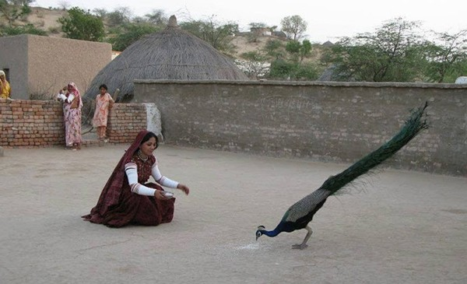
THANK YOU

